Slide 1
NCBA LOOP CASE STUDY
Country Integration
Service
Integrations and Microservices Engineer
Samuel Mutua Kimani
9 October 2026
Notes:
Final submission. Questions 1–10 follow in order; implementation evidence and production boundaries follow. Original brief and invitation reviewed locally. Deadline: 9 October 2026, 15:00 EAT.

Slide 2
1. Spring Boot application setup
Framework and dependencies
Java 25, Spring Boot 4.1.1, Maven wrapper; Web, validation, JPA, MySQL, Actuator and Flyway.
Separation of concerns
Controller handles HTTP; service coordinates operations; SOAP client/transport own integration; repository accesses MySQL.
Configuration and startup
Environment variables supply credentials and endpoint. Flyway creates fresh schemas; Hibernate validates them.
Samuel Mutua Kimani • 9 October 2026
02
Notes:
Sources: pom.xml, application.properties, Dockerfile. Java 25 / Spring Boot 4.1.1 dependencies resolved in clean verification.

Slide 3
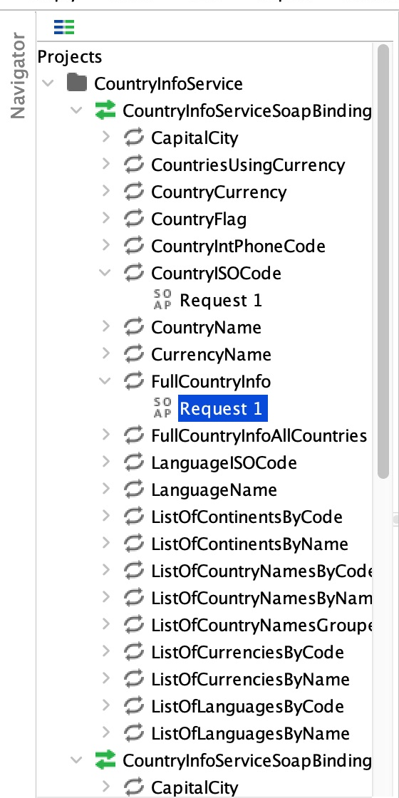
2. SoapUI import, request and assertions
CountryISOCode • actual Tanzania exchange
Request
<web:sCountryName>Tanzania</web:sCountryName>
HTTP 200 response
<m:CountryISOCodeResult>TZ</m:CountryISOCodeResult>
Passed: SOAP response • no fault • XPath result TZ
3 cases / 9 assertions: ISO Tanzania, FullCountryInfo TZ, ISO South Africa.
Reproduce: ./scripts/test-soapui.sh
Samuel Mutua Kimani • 9 October 2026
03
Notes:
Sources: actual imported-operation tree cropped from docs/soapui/soapui-import.png; docs/soapui/results/CountryInfo_smoke_tests-CountryISOCode__Tanzania-CountryISOCode-0-OK.txt and saved project. XML fragments below are extracted evidence, not a recreated screenshot. Native app capture failed with window/accessibility errors; full-window request screenshot is not included. Three cases and nine actual runner assertions passed.

Slide 4
3. Receive JSON and normalize the name
REST boundary
POST /api/countries accepts {"name":"kenya"}. Bean Validation rejects blank names and malformed JSON with 400.
Required first lookup
Trim and collapse whitespace, then sentence case: kenya → Kenya; south africa → South africa.
HTTP response
Successful import returns 201, the persisted country/languages and a Location header. Unknown country returns 404.
Samuel Mutua Kimani • 9 October 2026
04
Notes:
Sources: CountryController, CreateCountryRequest, CountryService and service/controller tests. The first provider request remains sentence case as requested.

Slide 5
4. Resolve ISO with provider-compatible names
CountryISOCode request
Send sCountryName in the SOAP envelope. Parse CountryISOCodeResult and validate the ISO code.
Correctness fix
After an unknown sentence-case result, title case includes punctuation: Guinea-Bissau and Papua-New Guinea now resolve.
Canonical spelling and cache
If needed, use the provider name catalogue with a six-hour TTL. Moldova, Republic of resolves to MD. Transport errors never trigger name-format fallback.
Samuel Mutua Kimani • 9 October 2026
05
Notes:
Sources: CountryService.resolveIsoCode, CountrySoapClient.findCanonicalCountryName, regression tests and docs/evidence/kubernetes-verification.json. Live imports GW/PG/MD returned 201.

Slide 6
5. Fetch and persist full country information
FullCountryInfo request
Use the resolved ISO code as sCountryISOCode. Read country fields and all returned languages.
Defensive parsing
Namespace-aware XML parsing, escaped request values, prohibited DOCTYPE/external entities, SOAP-fault and malformed-result checks.
Database consistency
SOAP finishes before save. A unique ISO constraint handles concurrent duplicates; the service maps the losing save to 409.
Samuel Mutua Kimani • 9 October 2026
06
Notes:
Sources: CountrySoapClient, CountryService, CountryInfo/Language entities; SOAP parsing tests; live verification.

Slide 7
6. JPA entities and request DTOs
CountryInfo and Language are JPA entities
CountryInfo persists country identity/details. Language persists ISO/name and its country relationship.
DTOs describe incoming requests
CreateCountryRequest and UpdateCountryRequest validate the REST input. They are distinct from database entities.
Persistence behavior
Generated IDs, unique country ISO, cascading save/delete and orphan removal. Tests verify language replacement and eager read paths.
Samuel Mutua Kimani • 9 October 2026
07
Notes:
Sources: model/CountryInfo.java, model/Language.java, dto/CreateCountryRequest.java, dto/UpdateCountryRequest.java; H2/MySQL persistence tests.

Slide 8
7. CRUD endpoints and bounded reads
Method | Route / behavior | Success
POST | /api/countries; import and save | 201 + Location
GET | /api/countries?page=0&size=100 | 200 JSON array
GET | /api/countries/{id} | 200 country
PUT | /api/countries/{id}; replace details/languages | 200 updated
DELETE | /api/countries/{id}; cascade languages | 204 empty
Zero-based pages; size 1–100. Read until an empty page for all countries. Invalid bounds return 400. ISO and country ID stay immutable on update.
Samuel Mutua Kimani • 9 October 2026
08
Notes:
Sources: CountryController/CountryService/CountryRepository. The collection response is still a JSON array; pages fetch countries first then selected relationships.

Slide 9
8. Kubernetes deployment scripts
Source-built image
Multi-stage Java 25 build; non-root runtime. A tag derived from Docker build inputs prevents stale local images.
Deploy and scale
./scripts/deploy.sh creates namespace/Secret, waits for MySQL, runs migrations with one app replica, then scales to two.
Cluster portability
Docker Desktop uses the local image; kind/minikube import it. Remote contexts require APP_IMAGE with registry path and PUSH_IMAGE=true.
Samuel Mutua Kimani • 9 October 2026
09
Notes:
Sources: scripts/deploy.sh, scripts/image-tag.py, k8s/app.yaml, k8s/mysql.yaml. Docker Desktop exercised; other platform branches are supplied but unverified here.

Slide 10
9. Run, test and deploy
From the project root
1 cp .env.example .env — replace both password placeholders
2 ./mvnw clean verify — 55 tests; no Docker or external DB
3 docker compose up -d --build — API localhost:8081
4 ./scripts/deploy.sh — Kubernetes, two replicas
5 Port-forward Service 8082:8080; run ./scripts/verify.sh
All 64 tests
./mvnw -Pmysql-it clean verify — Docker required for temporary MySQL.
Existing pre-Flyway database: backup first, explicit baseline once, then return baseline flag to false.
Samuel Mutua Kimani • 9 October 2026
10
Notes:
Sources: README.md and docs/DEPLOYMENT.md. Default tests need host Java 25; Docker builds compile without host Java. Existing-schema baseline must follow a private backup.

Slide 11
10. Troubleshoot Kubernetes
Image and startup
Check pod events, image tag and rollout; load the image for your cluster. Inspect logs for schema validation and datasource failures.
Readiness and upstream failures
Readiness includes MySQL; liveness does not. Check PVC, database access, SOAP timeouts, circuit state and outbound network access.
Resources and diagnostics
Inspect limits/probe timeouts, restart counts and Service endpoints. Use request IDs, business outcomes, Prometheus targets and Grafana.
Samuel Mutua Kimani • 9 October 2026
11
Notes:
Sources: docs/DEPLOYMENT.md and scripts/backup-db.sh. Never print Secret values or delete data volumes to bypass startup errors.

Slide 12
System design and integration trade-offs
REST client
Kubernetes Service
Two app replicas
Shared MySQL
SOAP provider
Stored CRUD
New imports only
Synchronous import gives an immediate result. Bulk queuing is a proposed extension requiring durable jobs, idempotency and dead-letter handling.
Samuel Mutua Kimani • 9 October 2026
12
Notes:
Sources: actual source layers, k8s Service/Deployment/MySQL; docs/REQUIREMENTS.md. These components are implemented.

Slide 13
Scaling: measured local read workload
Measurement | Observed local result
Requests / concurrency | 200 reads / 8 workers; all HTTP 200
Service distribution | 101 requests to one pod; 99 to the other
Rate / latency | 9.471 requests/s; p50 450 ms; p95 3,106 ms
Test scope | 21.118 s sample on one Docker Desktop node
Stateless replicas and shared MySQL support horizontal scaling. SQL pagination bounds reads; provider-name caching avoids repeated catalogue lookups.
HPA 2–4 replicas is configured, but this cluster lacks the metrics API. Autoscaling, sustained capacity and multi-node failover remain unverified.
Samuel Mutua Kimani • 9 October 2026
13
Notes:
Source: docs/evidence/load-results.json. 200 GET requests from a temporary Python pod to internal ClusterIP Service, concurrency eight. 8 GB Mac, about 4 GB Docker allocation; one node, two app replicas, one MySQL. Desktop/monitoring shared resources. No maximum capacity claim.

Slide 14
Resilience and HTTP error handling
Bounded external calls
5 s connection timeout; each request up to 8 s. At most two attempts, 300 ms apart. Overall SOAP sequence budget: 20 s.
Circuit breaker and degraded operation
10-call window; minimum five, 50% failure threshold; open 30 s, two half-open calls. Stored CRUD remains available during SOAP outages.
Explicit HTTP outcomes
400 invalid input, 404 missing country, 405 method, 406 Accept, 409 duplicate, 415 media type, 502 invalid upstream, 503 unavailable, 504 timeout.
Samuel Mutua Kimani • 9 October 2026
14
Notes:
Sources: SoapTransport, GlobalExceptionHandler, service/failure/transport tests. SOAP budget excludes servlet scheduling and database operations. Parsing faults occur outside the transport circuit.

Slide 15
Logs, metrics and deployed monitoring
Structured troubleshooting logs
Request ID, method/path/status/duration; import/ISO/save outcomes, duplicate detection and failure status. Update/delete log flushed results. Credentials and bodies excluded.
Business and HTTP metrics
country.operations outcomes, country.import.duration, HTTP request rate/latency and pod identity. Actuator exposes health and Prometheus metrics.
Verified local monitoring
Prometheus scraped two healthy targets and loaded availability/5xx rules. Grafana provisioned the country-service dashboard. Storage is ephemeral; local Viewer access only.
Samuel Mutua Kimani • 9 October 2026
15
Notes:
Sources: RequestLoggingFilter, CountryService, application.properties, k8s/optional/monitoring.yaml, docs/evidence/monitoring-verification.json. Evaluated alert rules have no external notification destinations.

Slide 16
64 automated tests passed
Suite | Tests | Evidence
Service / failure | 21 | Names, duplicate races, errors and CRUD
SOAP client | 10 | Canonical cache, namespaces, faults, XML safety
Controller / transport | 18 | POST/PUT, validation, timeout/budget/circuit
Context / H2 persistence | 6 | Startup and JPA behavior
Actual MySQL | 9 | Persistence, concurrency and Flyway migration
Default: ./mvnw clean verify → 55 tests, no Docker required
Full: ./mvnw -Pmysql-it clean verify → 64 tests, Docker required
Samuel Mutua Kimani • 9 October 2026
16
Notes:
Source: docs/TEST_RESULTS.md, docs/evidence/test-results.json and sanitized JUnit exports. Clean full run finished 9 October at 12:53:43 EAT. No failures/errors/skips. Hosted CI tests and Docker build must be checked for final pushed commit.

Slide 17
Final deployment verification
Data preserved and schema validated
Existing Kenya, Tanzania and South Africa survived Flyway adoption. Baseline was explicitly enabled once and then disabled. A private dump restored into disposable MySQL with all six countries and languages.
Correctness and shared persistence
Guinea-Bissau → GW, Papua-New Guinea → PG, Moldova → MD: each created with 201 and read through the other replica. Duplicate 409; unknown 404.
Ready application and evidence
Two ready backends; health/readiness/liveness UP; zero app/MySQL restarts. Pagination, business metrics and internal Service distribution verified.
Samuel Mutua Kimani • 9 October 2026
17
Notes:
Source: docs/evidence/kubernetes-verification.json, monitoring-verification.json, load-results.json. Fresh source image build-b3d64cbfb5ab61f8; both replicas and MySQL ready without restarts. Legacy schema baselined explicitly then flag disabled; KE/TZ/ZA data retained.

Slide 18
Submission and production boundaries
Assessment deliverables
Source, tests and CI; SoapUI project/results; Docker and Kubernetes scripts; deployment/troubleshooting guides; requirement mapping; presentation and PDF.
Proposed production architecture
Multiple nodes/zones and a managed HA database; authenticated TLS ingress; managed secrets; durable monitoring and alert destinations; tested backups and recovery.
Remaining validation
Local results do not prove HA or peak capacity. HPA behavior, sustained mixed load/fault tests, production recovery exercises and upstream HTTPS need the corresponding environment.
github.com/kimtour/country-integration-service
Samuel Mutua Kimani • 9 October 2026
18
Notes:
Sources: original brief/invitation, docs/REQUIREMENTS.md, deployment/test/evidence files. Repository URL is public; package prepared for reply by 15:00 EAT on 9 October 2026. Email is not sent by preparation.

